Slide 1

Lecture 6: Clustering and k-mean
COSC 526: Introduction to Data Mining
Spring 2020
1
1

Slide 2

Instructor:
GRA:
Mike Wyatt
Nigel Tan
2
2

Slide 3
Today Outline
Clustering and k-mean
Linear regression
Assignment 6

Slide 4
Clustering
4

Slide 5
Clustering
Clustering is the task of grouping a set of objects in such a way that objects in the same group (called a cluster) are more similar (in some sense) to each other than to those in other clusters
Popular notions of clusters include groups with small distances between cluster members or dense areas of the data space
K-mean: partition n observations into k clusters
DBSCAN: density based clustering algorithm

Slide 6
Clustering
Unsatisfactory k-means for clustering the Iris flower dataset
https://en.wikipedia.org/wiki/Iris_flower_data_set

Slide 7
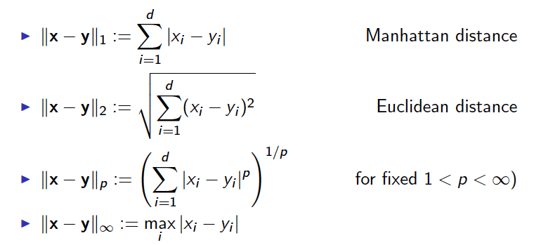
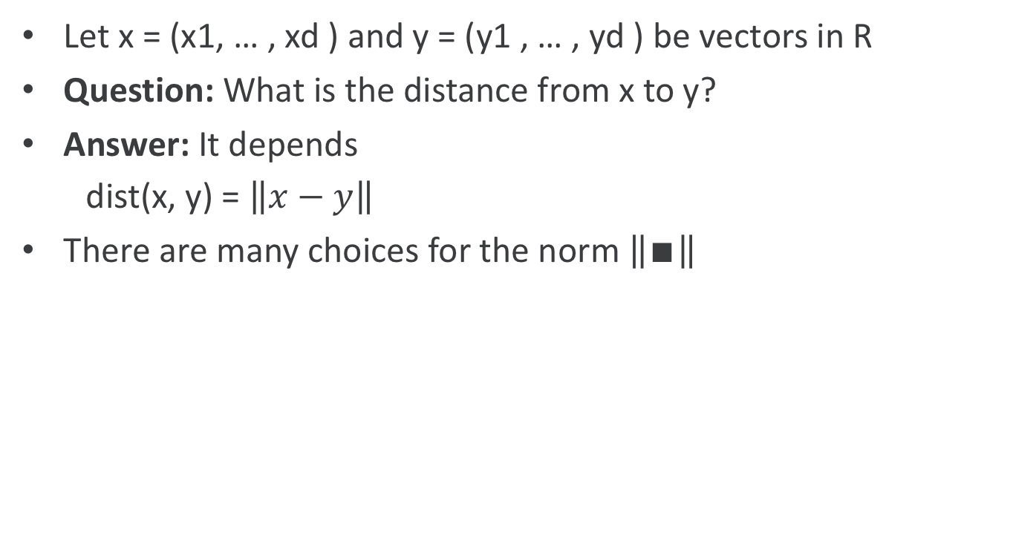
Distance Between Vectors
Let x = (x1, … , xd ) and y = (y1 , … , yd ) be vectors in R
Question: What is the distance from x to y?
Answer: It depends
dist(x, y) = $\left\|x−y\right\|$
There are many choices for the norm $\left\|∎\right\|$

Slide 8
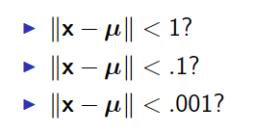
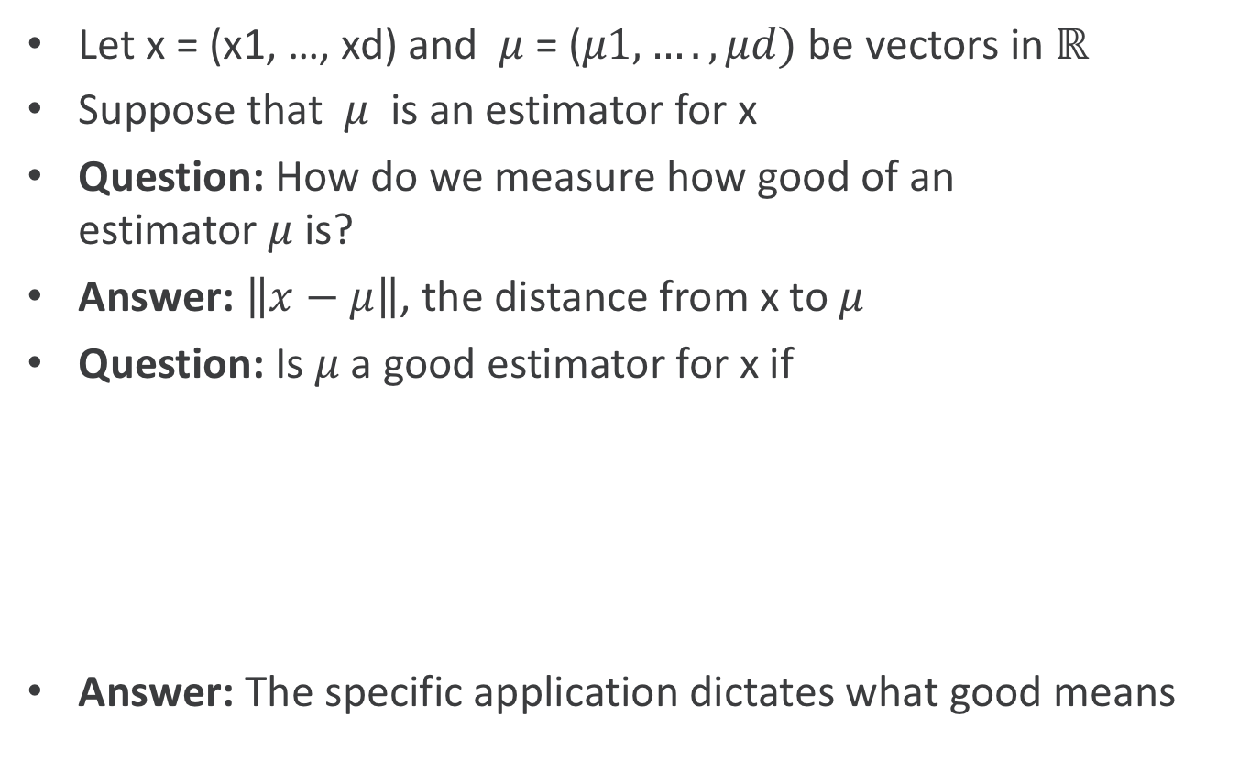
Estimators and Errors
Let x = (x1, …, xd) and $μ$= ($μ1, …., μd)$ be vectors in $ℝ$
Suppose that $μ$ is an estimator for x
Question: How do we measure how good of an estimator $μ$is?
Answer: $\left\|x−μ\right\|$, the distance from x to $μ$
Question: Is $μ$a good estimator for x if
Answer: The specific application dictates what good means

Slide 9
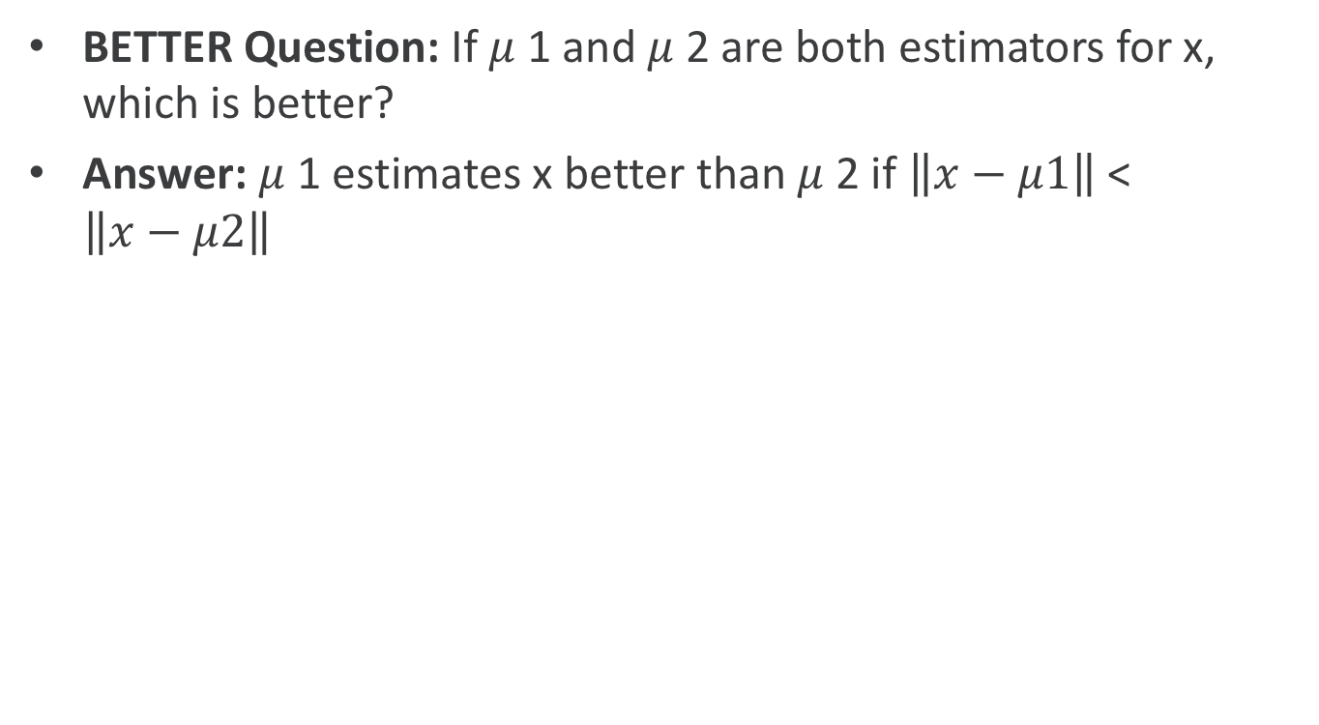
Estimators and Error
BETTER Question: If $μ$1 and $μ$2 are both estimators for x, which is better?
Answer: $μ$1 estimates x better than $μ$2 if $\left\|x−μ1\right\|$ < $\left\|x−μ2\right\|$

Slide 10
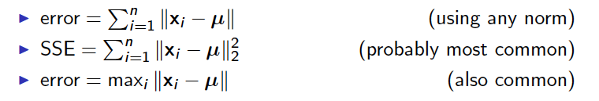
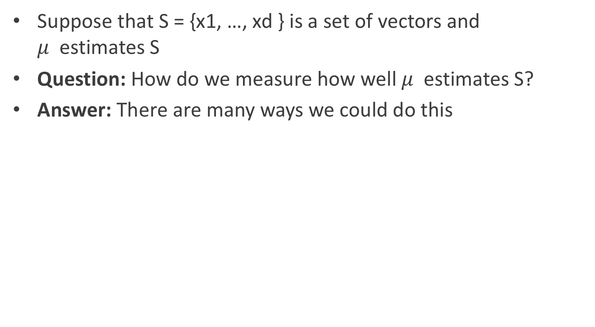
Estimators and Error
Suppose that S = {x1, …, xd } is a set of vectors and $μ$ estimates S
Question: How do we measure how well $μ$ estimates S?
Answer: There are many ways we could do this
SSE: sum of squared errors of prediction

Slide 11
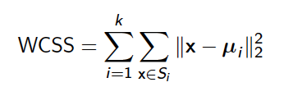
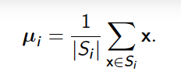
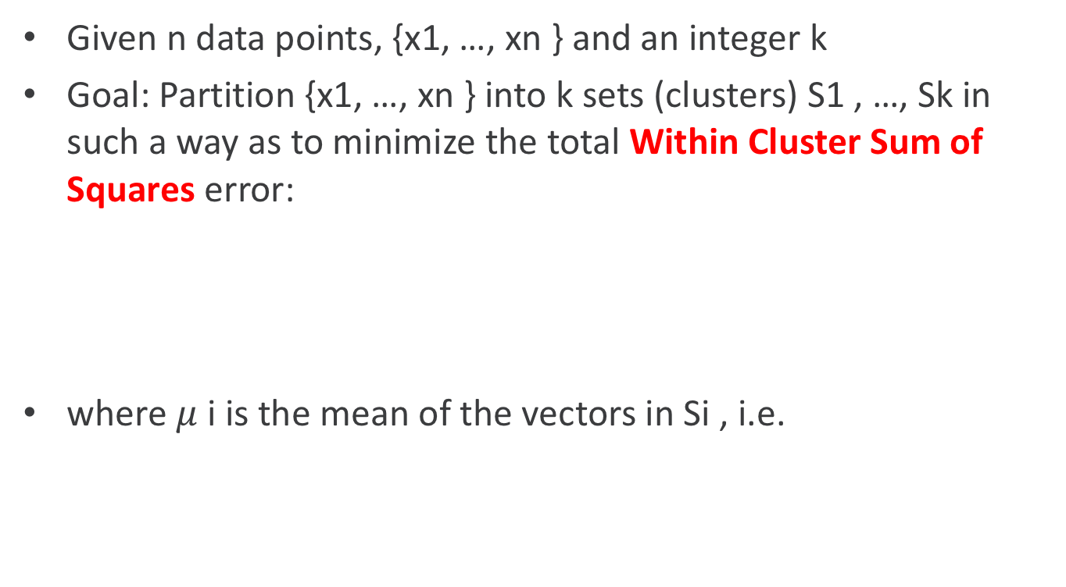
K-mean clustering
Given n data points, {x1, …, xn } and an integer k
Goal: Partition {x1, …, xn } into k sets (clusters) S1 , …, Sk in such a way as to minimize the total Within Cluster Sum of Squares error:
where $μ$i is the mean of the vectors in Si , i.e.
measure of the variability of the observations within each cluster
https://support.minitab.com/en-us/minitab/18/help-and-how-to/modeling-statistics/multivariate/how-to/cluster-k-means/interpret-the-results/all-statistics-and-graphs/

Slide 12
Number of observations
The number of observations in each cluster in the final partition
Examine the number of observations in each cluster when you interpret the measures of variability, such as the average distance and the within-cluster sum of squares. The variability of a cluster may be affected by its having a smaller or larger number of observations. For example, the within-cluster sum of squares becomes larger as more observations are added.
Examine clusters that have significantly fewer observations than other clusters. Clusters that have very few observations may contain outliers or unusual observations with unique characteristics.
https://support.minitab.com/en-us/minitab/18/help-and-how-to/modeling-statistics/multivariate/how-to/cluster-k-means/interpret-the-results/all-statistics-and-graphs/

Slide 13
Cluster centroid
The middle of a cluster. A centroid is a vector that contains one number for each variable, where each number is the mean of a variable for the observations in that cluster. The centroid can be thought of as the multi-dimensional average of the cluster.
Use the cluster centroid as a general measure of cluster location and to help interpret each cluster
Each centroid can be seen as representing the "average observation" within a cluster across all the variables in the analysis
https://support.minitab.com/en-us/minitab/18/help-and-how-to/modeling-statistics/multivariate/how-to/cluster-k-means/interpret-the-results/all-statistics-and-graphs/

Slide 14
Average distance from centroid
The average of the distances from observations to the centroid of each cluster
The average distance from observations to the cluster centroid is a measure of the variability of the observations within each cluster
A cluster that has a smaller average distance is more compact than a cluster that has a larger average distance
Clusters that have higher values exhibit greater variability of the observations within the cluster
https://support.minitab.com/en-us/minitab/18/help-and-how-to/modeling-statistics/multivariate/how-to/cluster-k-means/interpret-the-results/all-statistics-and-graphs/

Slide 15
Maximum distance from centroid
The maximum of the distances from observations to the centroid of each cluster.
The maximum distance from observations to the cluster centroid is a measure of the variability of the observations within each cluster
A higher maximum value, especially in relation to the average distance, indicates an observation in the cluster that lies farther from the cluster centroid
https://support.minitab.com/en-us/minitab/18/help-and-how-to/modeling-statistics/multivariate/how-to/cluster-k-means/interpret-the-results/all-statistics-and-graphs/

Slide 16
Within cluster sum of squares
The sum of the squared deviations from each observation and the cluster centroid
The within-cluster sum of squares is a measure of the variability of the observations within each cluster.
A cluster that has a small sum of squares is more compact than a cluster that has a large sum of squares
Clusters that have higher values exhibit greater variability of the observations within the cluster
https://support.minitab.com/en-us/minitab/18/help-and-how-to/modeling-statistics/multivariate/how-to/cluster-k-means/interpret-the-results/all-statistics-and-graphs/

Slide 17
Within cluster sum of squares
The within-cluster sum of squares is influenced by the number of observations
As the number of observations increases, the sum of squares becomes larger
The within-cluster sum of squares is often not directly comparable across clusters with different numbers of observations
To compare the within-cluster variability of different clusters, use the average distance from centroid instead
https://support.minitab.com/en-us/minitab/18/help-and-how-to/modeling-statistics/multivariate/how-to/cluster-k-means/interpret-the-results/all-statistics-and-graphs/

Slide 18
Distances between cluster centroids
The distances between cluster centroids measures how far apart the centroids of the clusters in the final partition are from one another.
The distance values are not very informative by themselves but they are important when considered all together to see how different the clusters are from each other
A larger distance generally indicates a greater difference between the clusters

Slide 19
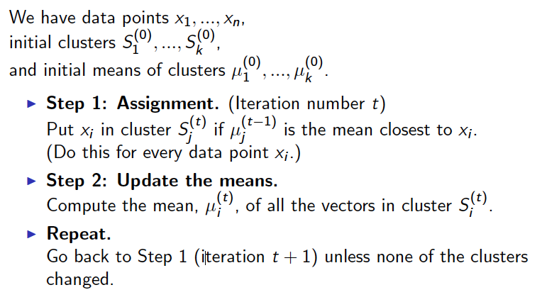
k-means clustering

Slide 20
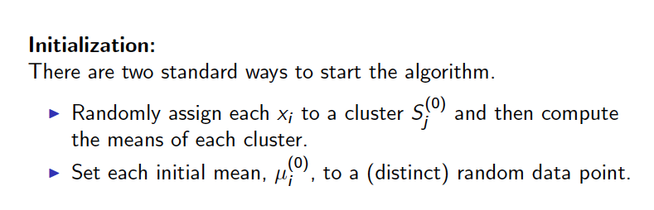
k-means clustering

Slide 21
k-Clustering with k = 3, initial assignment

Slide 22
k-Clustering with k = 3, points changing cluster

Slide 23
k-Clustering with k = 3, after rst iteration

Slide 24
k-Clustering with k = 3, points changing cluster

Slide 25
k-Clustering with k = 3, after second iteration

Slide 26
k-Clustering with k = 3, points changing cluster

Slide 27
k-Clustering with k = 3, after third iteration

Slide 28
k-Clustering with k = 3, points changing cluster

Slide 29
k-Clustering with k = 3, after fourth iteration

Slide 30
k-Clustering with k = 3, points changing cluster

Slide 31
k-Clustering with k = 3, after fth iteration

Slide 32
k-Clustering with k = 3, points changing cluster

Slide 33
k-Clustering with k = 3, after sixth iteration

Slide 34
k-Clustering with k = 3, points changing cluster

Slide 35
k-Clustering with k = 3, after seventh iteration

Slide 36
k-Clustering with k = 3, points changing cluster

Slide 37
k-Clustering with k = 3, after eighth iteration

Slide 38
k-Clustering with k = 3, points changing cluster? (No.)

Slide 39
k-Clustering with k = 3, nished.

Slide 40
k-means clustering
Advantages:
I tends to converge very fast, O(n)
Disadvantages:
finds a locally optimal set of clusters
requires the user to specify the
number of clusters
tends to produce clusters that are
similarly sized Voronoi cells
http://informationandvisualization.de/blog/
kmeans-and-voronoi-tesselation-built-processing

Slide 41
k-means clustering versus DBSCAN

Slide 42
Finding k
Different techniques:
Elbow method --> open Jupyter code
code_elbow_method.ipynb
Dendrogram
Silhouette score Analysis
http://www.awesomestats.in/python-cluster-validation/

Slide 43
Elbow method
Method of interpretation and validation of consistency within cluster analysis:
help finding the appropriate number of clusters in a dataset
Look at the percentage of variance explained as a function of the number of clusters
Choose a number of clusters so that adding another cluster does not give much better modeling of the data

Slide 44
Elbow method
Compute clustering algorithm (e.g., k-means clustering) for different values of k
By varying k from 1 to 10 clusters
For each k, calculate the total within-cluster sum of square (wss)
Plot the curve of wss according to the number of clusters k
The location of a bend (knee) in the plot is generally considered as an indicator of the appropriate number of clusters
http://www.sthda.com/english/articles/29-cluster-validation-essentials/96-determining-the-optimal-number-of-clusters-3-must-know-methods/#elbow-method

Slide 45
Linear Regression
45

Slide 46
Linear regression
Given a set of data points in the plane, (x1; y1); ….; (xn; yn), find an equation of the line y = mx + b that best describes the points

Slide 47
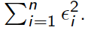
Linear regression
What does the best mean? (In terms of a best t line.)
It is the line which minimizes the sum-of-squares error:

Slide 48
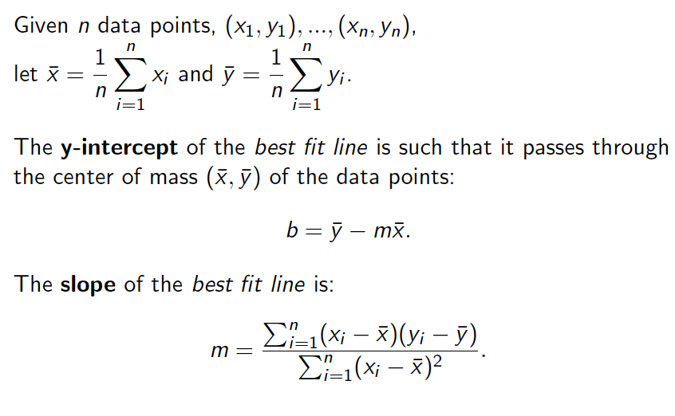
Linear regression

Slide 49
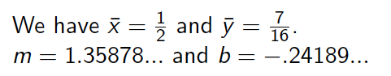
Linear regression
Given a set of data points in the plane, (x1; y1); ….; (xn; yn), find an equation of the line y = mx + b that best describes the points

Slide 50
Assignment 6
50

Slide 51
Assignment 6
During today's lecture, we learned about k-means clustering.
In the previous assignment, we learned to use PySpark's parallel versions of the map and reduce functions.
In this assignment, we will be implementing the k-means algorithm in parallel with PySpark.

